Slide 1

IoT Dashboard Security Demonstration
Brute Force, MFA, CSRF, Logging & Visualization

Slide 2
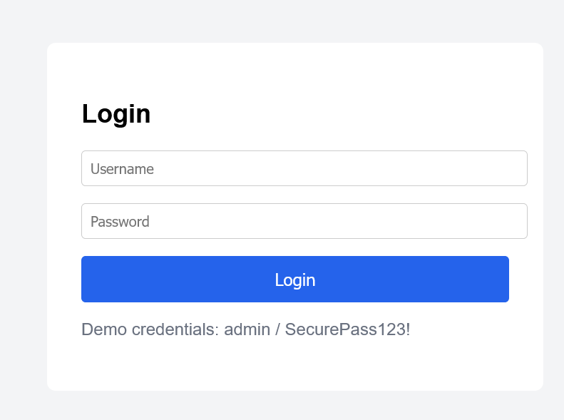
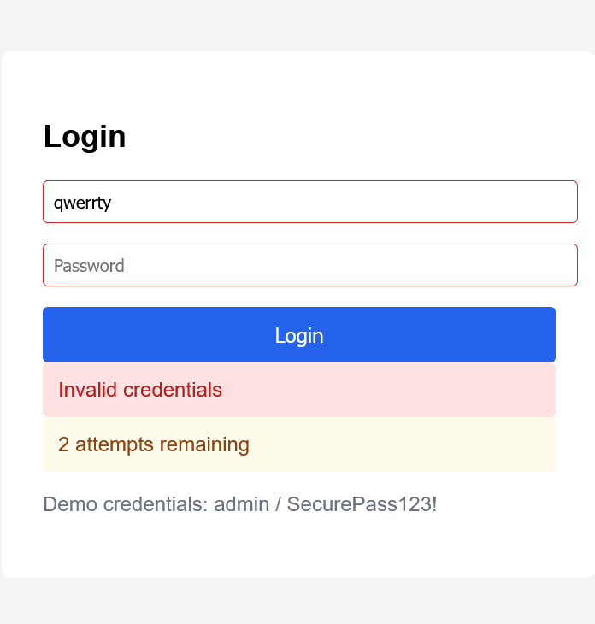
Access to website
HTTPS for secure access.
Prevent Brute force attack by limiting login attempts to 3 chances.

Slide 3
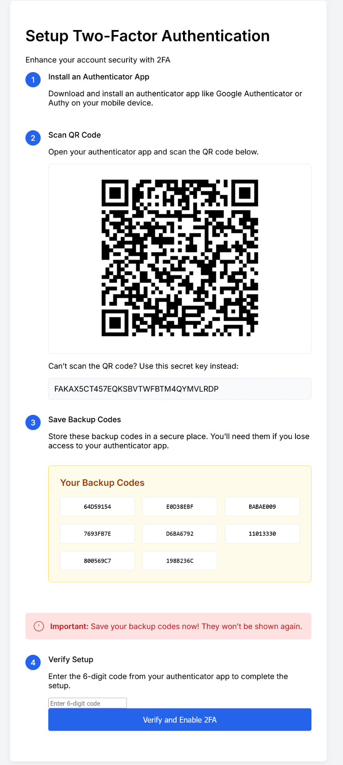
MFA to prevent Phishing

Slide 4
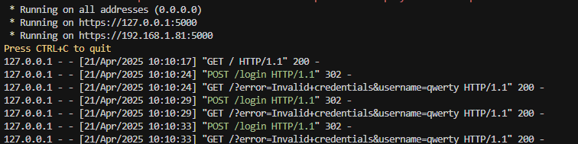
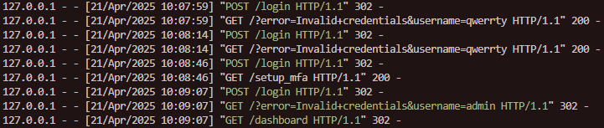
Logs for PUT and GET when accessed

